Slide 1




Qiskit Advocate Mentorship Program Quantum Graph Recurrent Neural Networks
Eraraya Ricardo Muten (Edo)
Quantum Technology Lab, Bandung Institute of Technology
Mentor: Anna Phan Research Scientist at IBM Quantum
Project: #43 QML Qiskit Implementations – Quantum Graph Recurrent Neural Networks
More info:

Slide 2
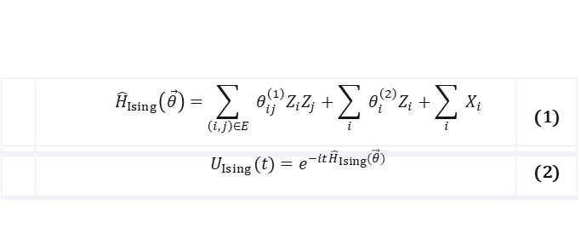
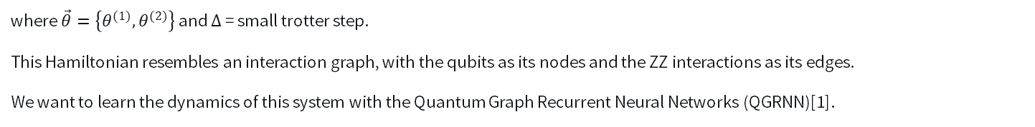
Project Description
Let’s imagine that we have a quantum system that can be described by a quadratic Hamiltonian. We also have the low-energy state, $|ψ_{0}〉$, of this system. We can access this system and sample the time evolution of this low-energy state at a particular time $t$.
Transverse-field Ising model:
where $\vec{θ}=\left\{θ^{(1)},θ^{(2)}\right\}$ and $Δ$ = small trotter step.
This Hamiltonian resembles an interaction graph, with the qubits as its nodes and the ZZ interactions as its edges.
We want to learn the dynamics of this system with the Quantum Graph Recurrent Neural Networks (QGRNN)[1].
[1] Verdon G, McCourt T, Luzhnica E, Singh V, Leichenauer S, Hidary J. Quantum Graph Neural Networks. ArXiv 2019.

Slide 3
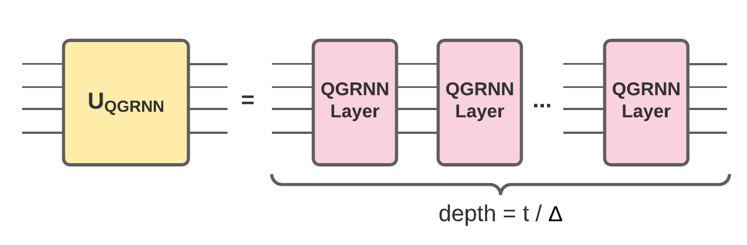
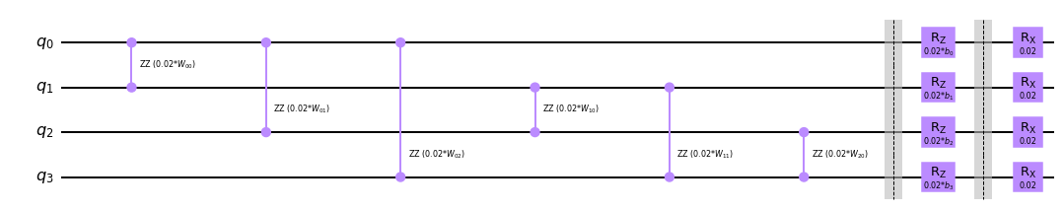
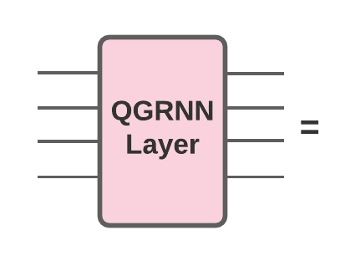
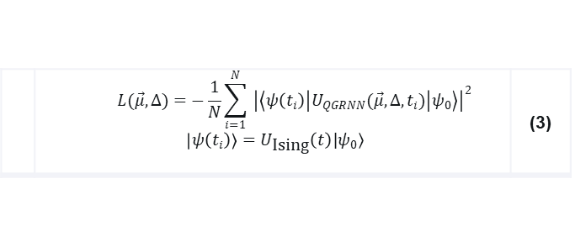
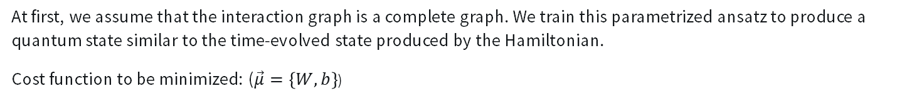
Project Description
Schematic below is the example of QGRNN ansatz for the four qubits case, with $W$ and $b$ are the variational parameters.
At first, we assume that the interaction graph is a complete graph. We train this parametrized ansatz to produce a quantum state similar to the time-evolved state produced by the Hamiltonian.
Cost function to be minimized: ($\vec{μ}=\left\{W,b\right\}$)

Slide 4
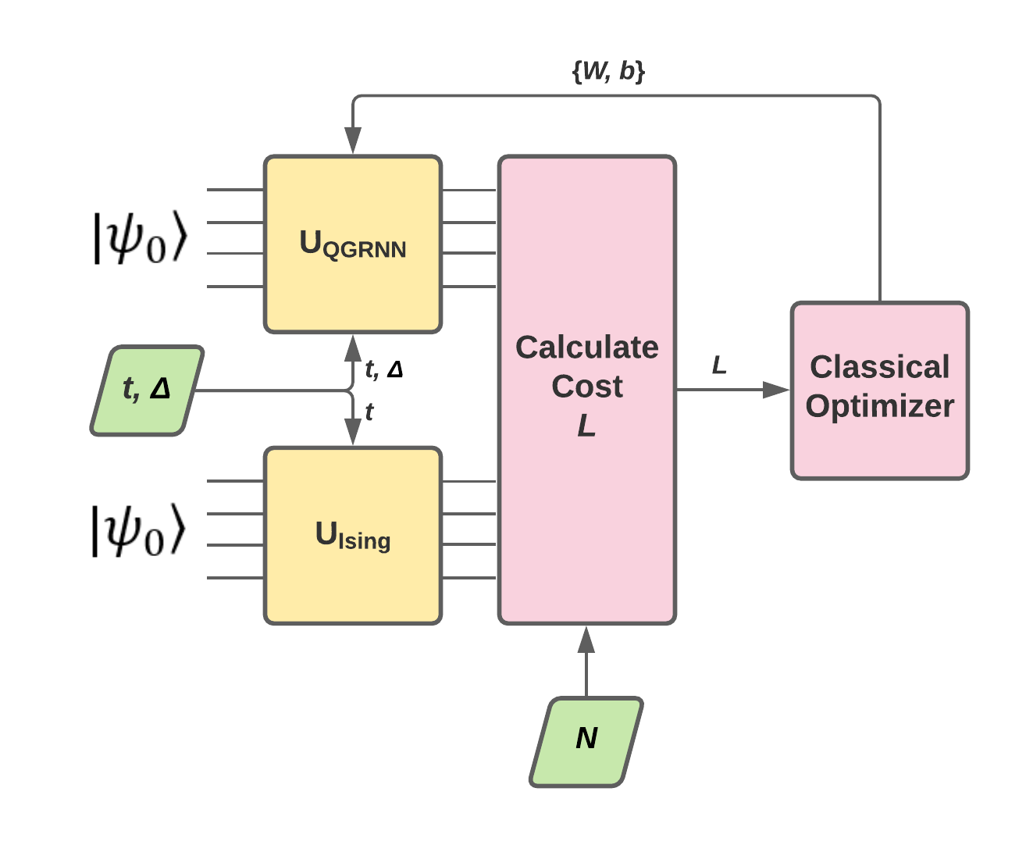
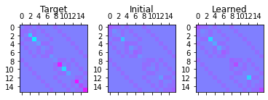
Result
Diagram below shows the overall algorithm.
Training converges: QGRNN unitary will be similar to the Ising Hamiltonian unitary.
Here is an example of a Hamiltonian that is learned by the QGRNN.

